Slide 1
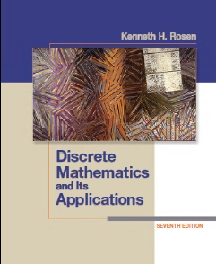
CSE 101: Discrete Mathematics
Slide 09
Number Theory
Presented by
Md. Sultanul Islam Ovi
Lecturer
Department of Computer Science and Engineering(CSE)
Green University of Bangladesh(GUB)
Notes:
‹#›

Slide 2
Importance of Number Theory
Number theory is crucial for encryption algorithms and hence to security.
Of utmost importance to everyone from Bill Gates, to the CIA, to Osama Bin Laden.
The encryption algorithms depend heavily on modular arithmetic.
Machinery (notations and techniques) for manipulating numbers.
Numbers are of two types (PARITY): EVEN(2k) or ODD(2k - 1)
Even + Even = Even
Even + Odd = Odd
Odd + Odd = Even
Even X Even = Even
Even X Odd = Even
Odd X Odd = Odd

Slide 3
Divisors
DEF: Let a, b and c be integers such that
a = b ·c
b and c are factors of a
a is said to be a multiple of b (as well as of c).
The pipe symbol “|” denotes “divides” so the situation is summarized by:
b | a ∧ c | a .

Slide 4
Divisors Examples
Which of the following is true?
77 | 7
7 | 77
24 | 24
0 | 24
24 | 0
7 | -14
False bigger number can’t divide smaller positive number
True because 77 = 7 · 11
True because 24 = 24 · 1
False only 0 is divisible by 0
True 0 is divisible by every number (0 = 24 · 0)
True because -14 = 7 . (-2)

Slide 5
Multiples up to given n
How many positive multiples of 15 are less than 100?
Just list them: 15, 30, 45, 60, 75, 90
Therefore the answer is 6.
Q: How many positive multiples of 15 are less than 1,000,000?
A: Listing is too much of a hassle. ⎣1,000,000/15⎦.
In general: The number of d-multiples less than N is given by:
|{m ∈ Z⁺ | d |m and m ≤ N }| = ⎣N/d⎦

Slide 6
Divisor Theorem
Let a, b, and c be integers. Then:
a|b ∧ a|c 🡪 a|(b + c )
a|b 🡪 a|bc
a|b ∧ b|c 🡪 a|c
17|34 ∧ 17|170 🡪 17|204
17|34 🡪 17|340
6|12 ∧ 12|144 🡪 6 | 144

Slide 7
Divisor Theorem
In general, such statements are proved by starting from the definitions and manipulating to get the desired results.
EG. Proof of no. 2 (a|b 🡪 a|bc ):
Suppose a|b.
Then there exist m such that b = am.
Multiply both sides by c to get bc = amc = a (mc ).
Consequently, bc has been expressed as a times the integer mc so by definition of “|”, a|bc 

Slide 8
Prime Numbers
A number n ≥ 2 prime if it is only divisible by 1 and itself.
A number n ≥ 2 which isn’t prime is called composite.
Q: Which of the following are prime?
0,1,2,3,4,5,6,7,8,9,10
A: 0, and 1 not prime since not positive and greater or equal to 2
2 is prime as 1 and 2 are only factors. 3 is prime as 1 and 3 are only factors.
4,6,8,10 not prime as non-trivially divisible by 2.
5, 7 prime.
9 = 3 · 3 not prime.
Last example shows that not all odd numbers are prime.

Slide 9
Fundamental Theorem of Arithmetic
Any number n ≥ 2 is expressible as a unique product of 1 or more prime numbers.
Note: prime numbers are considered to be “products” of 1 and prime.
We’ll need induction and some more number theory tools to prove this.

Slide 10
Fundamental Theorem of Arithmetic
Q: Express each of the following number as a product of primes: 22, 100, 12, 17
22 = 2·11,
100 = 2·2·5·5,
12 = 2·2·3,
17 = 17

Slide 11
Primality Testing
Prime numbers are very important in encryption schemes. Essential to be able to verify if a number is prime or not. It turns out that this is quite a difficult problem.
First try:
boolean isPrime(integer n)
if ( n < 2 ) return false
for(i = 2 to n -1)
if( i |n ) // “divides”
return false
return true

Slide 12
Primality Testing
Q: What is the running time of this algorithm?
A: Assuming divisibility testing is a basic operation –then above primality testing algorithm is O (n).
Q: What is the running time in terms of the input size k ?
A: Consider n = 1,000,000. The input size is k = 7 because n was described using only 7 digits. In general we have
n = O (10^{k} ). Therefore, running time is O (10^{k} ).
Q: Can we improve the algorithm?

Slide 13
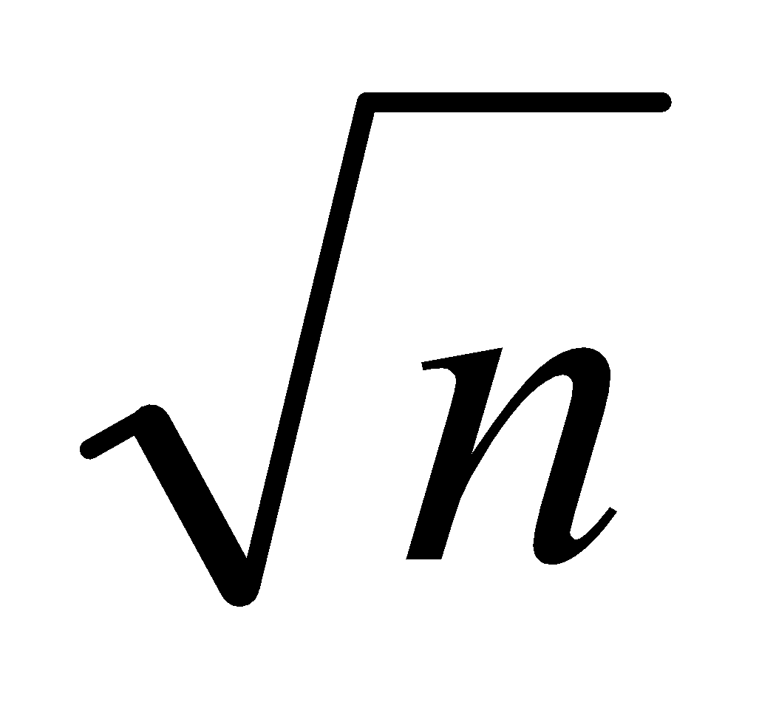
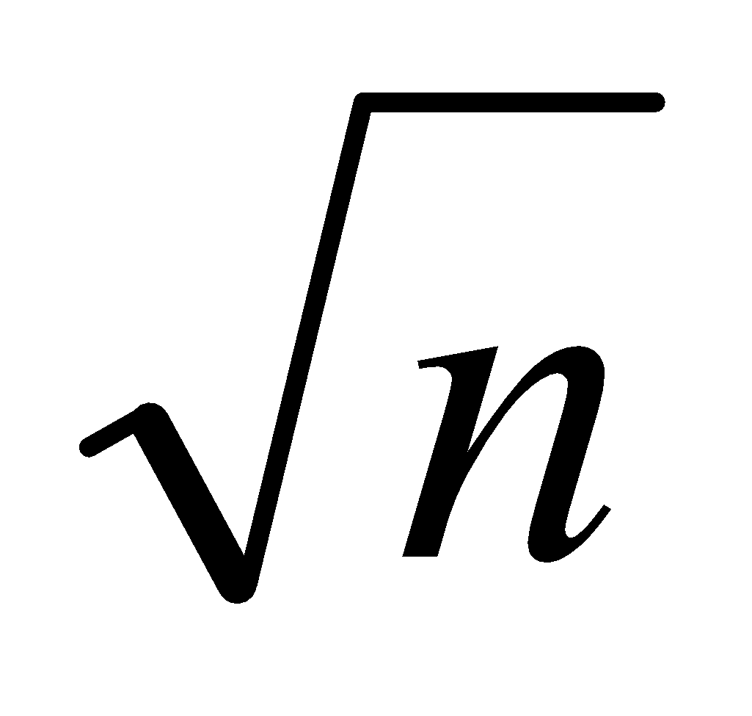
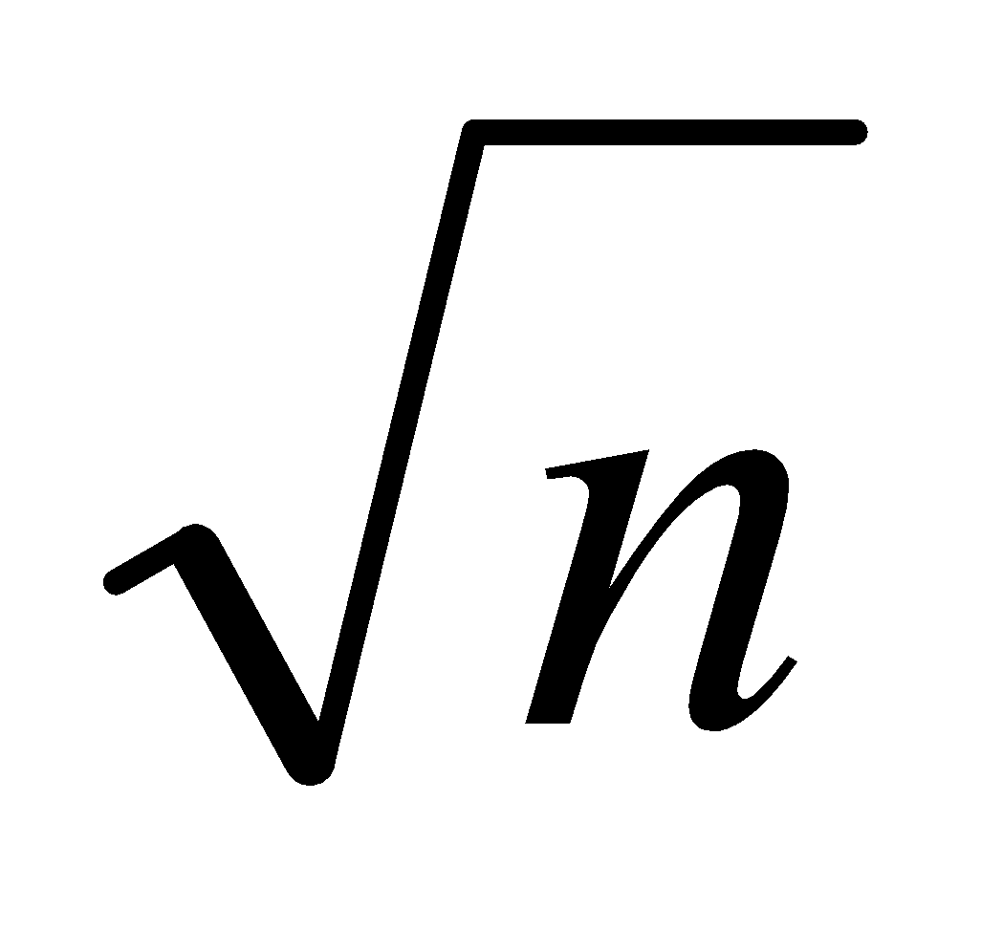
Primality Testing
A: Don’t try number bigger than n/2
After trying 2, don’t try any other even numbers, because know n is odd by this point.
In general, try only smaller prime numbers
In fact, only need to try to divide by prime numbers no larger than as we’ll see next:
LEMMA: If n is a composite, then its smallest prime factor is ≤
Proof (by contradiction). 1<a<n
n=ab =====> a<=n or b<=n
if a> and b> then ab> n

Slide 14
Primality Testing
EG: Test if 139 and 143 are prime.
List all primes up to and check if they divide the numbers.
2: Neither is even
3: Sum of digits trick: 1+3+9 = 13, 1+4+3 = 8 so neither divisible by 3
5: Don’t end in 0 or 5
7: 140 divisible by 7 so neither div. by 7
11: Alternating sum trick: 1-3+9 = 7 so 139 not div by 11. 1-4+3 = 0 so 143 is divisible by 11.
STOP! Next prime 13 need not be examined since bigger than .
Conclude: 139 is prime, 143 is composite.

Slide 15
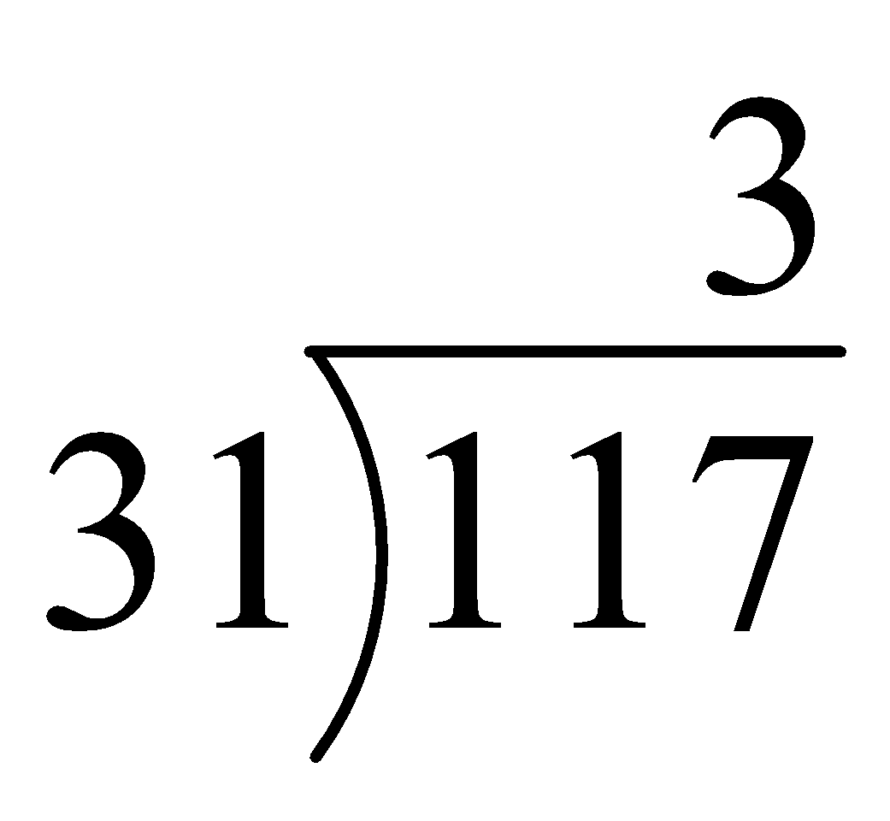
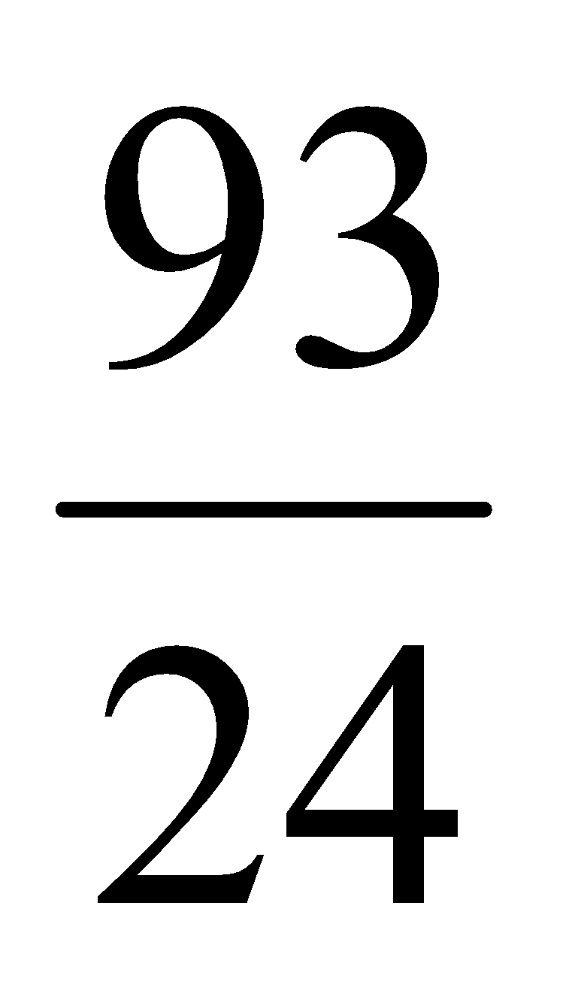
Division
Remember long division?
d the divisor
q the quotient
117 = 31·3 + 24
a = dq + r
a the dividend
r the remainder
THM: Let a be an integer, and d be a positive integer. There are unique integers q, r with r ∈ {0,1,2,…,d-1} satisfying a = dq + r

Slide 16
GCD and Relatively Prime
Let a,b be integers, not both zero. The greatest common divisor of a and b or gcd(a,b) is the biggest number d which divides both a and b.
a and b are said to be relatively prime if gcd(a,b) = 1, so no prime common divisors.
gcd(11,77) = 11
gcd(33,77) = 11
gcd(24,36) = 12
gcd(24,25) = 1. Therefore 24 and 25 are relatively prime.
NOTE: A prime number are relatively prime to all other numbers which it doesn’t divide.

Slide 17
GCD and Relatively Prime
EG: More realistic. Find gcd(98,420).
Find prime decomposition of each number and find all the common factors:
98 = 2·49 = 2·7·7
420 = 2·210 = 2·2·105 = 2·2·3·35 = 2·2·3·5·7
Underline common factors: 2·7·7, 2·2·3·5·7
Therefore, gcd(98,420) = 14

Slide 18
Least Common Multiple
The least common multiple of a, and b (lcm(a,b) ) is the smallest number m which is divisible by both a and b.
Find the lcm:
lcm(10,100) = 100
lcm(7,5) = 35
lcm(9,21) = 63
lcm(a,b) = ab / gcd(a,b)

Slide 19
Modular Arithmetic
There are two types of “mod” (confusing):
the mod function
Inputs a number a and a base b
Outputs a mod b a number between 0 and b –1 inclusive
This is the remainder of a÷b
the (mod) congruence
Relates two numbers a, b to each other relative some base n
a ≡ b (mod n) means that a and b have the same remainder when dividing by n

Slide 20
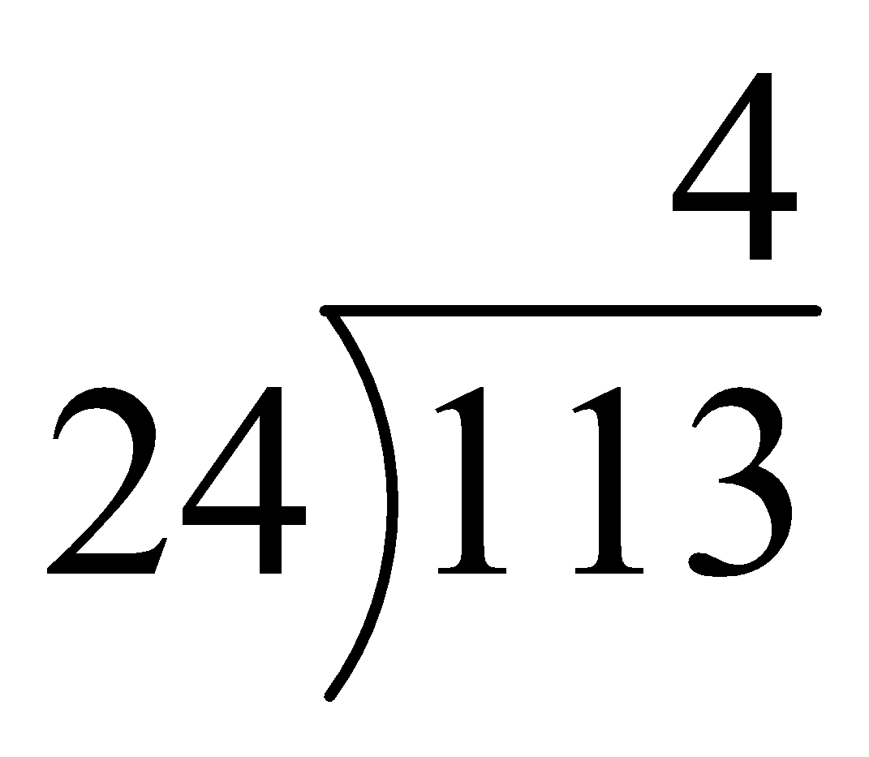
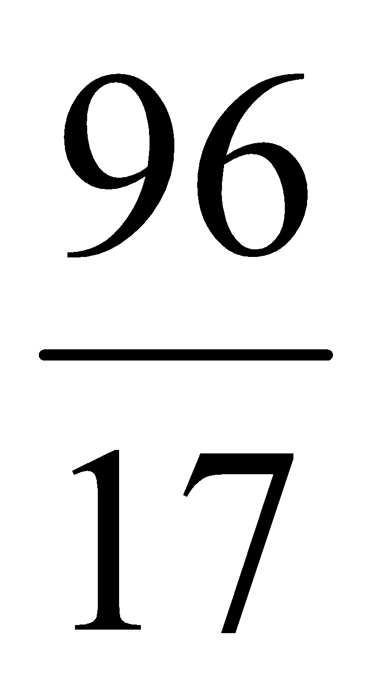
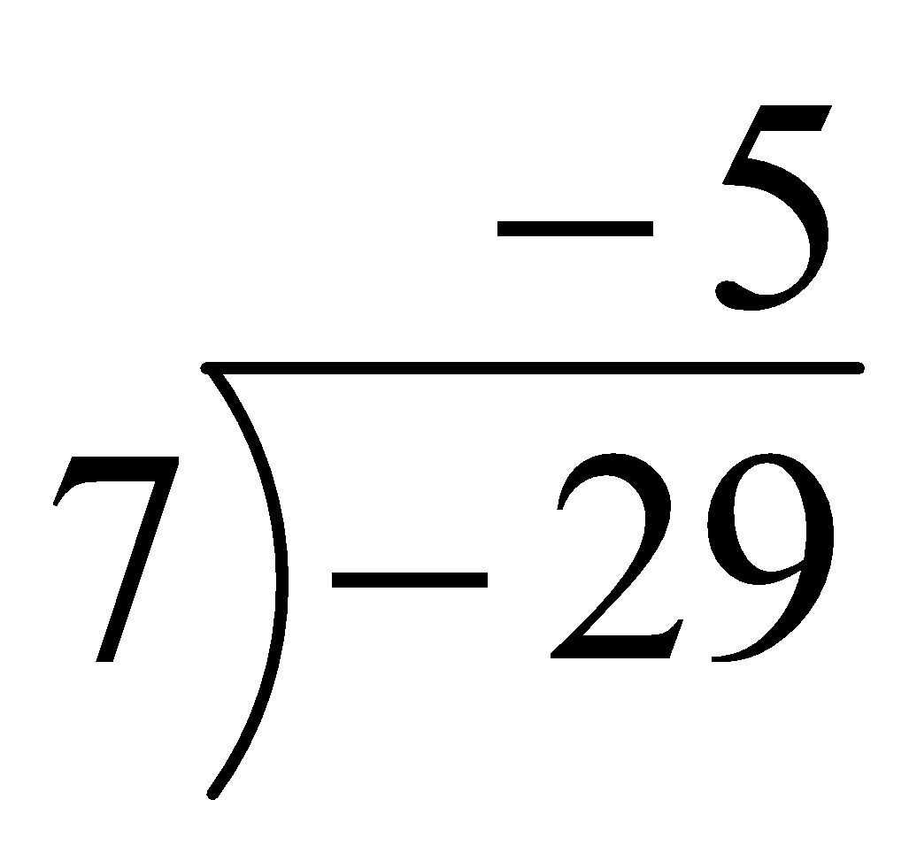
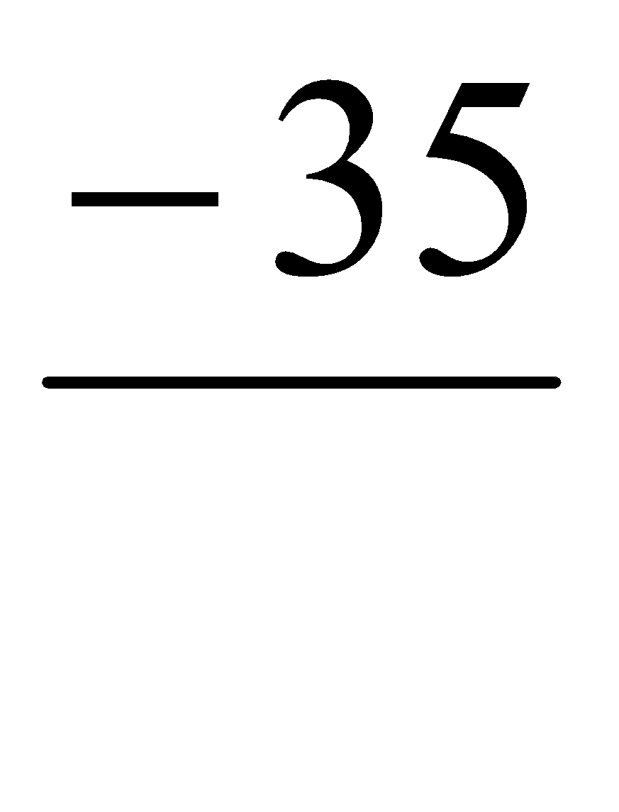
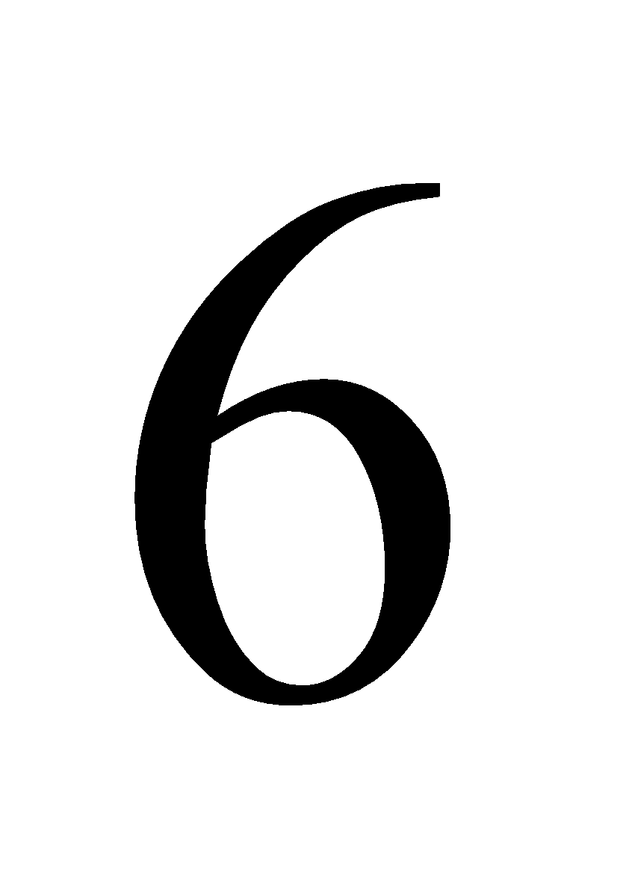
mod function
answer is always positive. E.G.
-10 mod 3 = 2.
A: Compute
113 mod 24
-29 mod 7

Slide 21
(mod) congruence Formal Definition
Let a,b be integers and n be a positive integer. We say that a is congruent to b modulo n (denoted by a ≡ b (mod n) ) iff n | (a – b ).
Equivalently: a mod n = b mod n
Which of the following are true?
3 ≡ 3 (mod 17)
3 ≡ -3 (mod 17)
172 ≡ 177 (mod 5)
-13 ≡ 13 (mod 26)
True.
False. (3-(-3)) = 6 isn’t divisible by 17.
True. 172-177 = -5 is a multiple of 5
True. -13-13 = -26 divisible by 26.

Slide 22
Modular arithmetic harder examples
A: Use the previous identities to help simplify:
Using multiplication rules, before multiplying (or exponentiating) can reduce modulo 102:
307¹⁰⁰¹ mod 102 ≡ 307¹⁰⁰¹ (mod 102)
≡ 1¹⁰⁰¹ (mod 102) (102X3)
≡ 1 (mod 102).
Therefore, 307¹⁰⁰¹ mod 102 = 1.

Slide 23
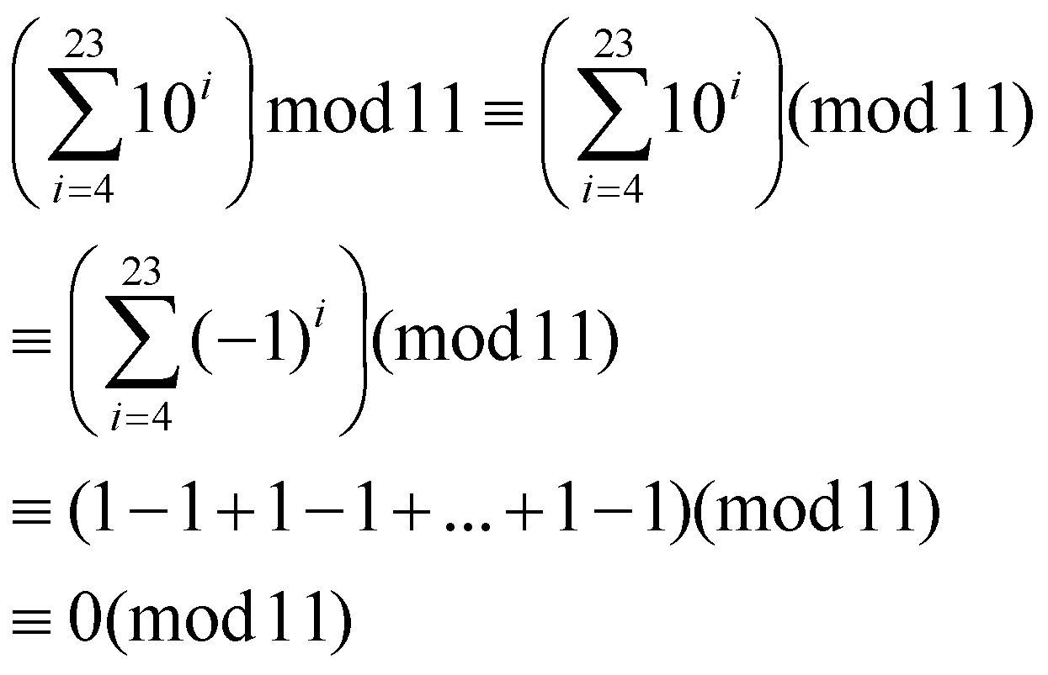
Modular arithmetic harder examples
A: Use the previous identities to help simplify:
2. Similarly, before taking sum can simplify modulo 11:
Therefore, the answer is 0.
10-(-1)

Slide 24
Simple Encryption
Variations on the following have been used to encrypt messages for thousands of years.
Convert a message to capitals.
Think of each letter as a number between 1 and 26.
Apply an invertible modular function to each number.
Convert back to letters (0 becomes 26).

Slide 25
Caesar Cipher
Example: replace each letter by 3rd letter on
f (a) = (a+3) mod 26
can define transformation as:
a b c d e f g h i j k l m n o p q r s t u v w x y z
D E F G H I J K L M N O P Q R S T U V W X Y Z A B C
mathematically give each letter a number
a b c d e f g h i j k l m n o p q r s t u v w x y z
0 1 2 3 4 5 6 7 8 9 10 11 12 13 14 15 16 17 18 19 20 21 22 23 24 25
then have Caesar cipher as:
cipher text, c = Encryption(p) = (p + k) mod (26)
plain text, p = Decryption(c) = (c – k) mod (26)
Example: Apply caesar cipher with k = 2 in the plain text “HELLO”

Slide 26
Monoalphabetic Cipher
rather than just shifting the alphabet
could shuffle (jumble) the letters arbitrarily
each plaintext letter maps to a different random ciphertext letter
hence key is 26 letters long
Plain: abcdefghijklmnopqrstuvwxyz
Cipher: DKVQFIBJWPESCXHTMYAUOLRGZN
only have 26 possible ciphers. A maps to A,B,..Z
could simply try each in turn
a brute force search
given ciphertext, just try all shifts of letters (1 to 25)
do need to recognize when have plaintext
Notes:
‹#›
With only 25 possible keys, the Caesar cipher is far from secure. A dramatic increase in the key space can be achieved by allowing an arbitrary substitution, where the translation alphabet can be any permutation of the 26 alphabetic characters.
See example translation alphabet, and an encrypted message using it.

Slide 27
Rail Fence Cipher
It rearranges the order of plain text.
N = number of rails
Example: Apply Rail Fence Cipher with n = 2 in the plain text “Welcome to the class”
w l o e o h c a s
e c m t t e l s
Cipher Text: wloeohcasecmttels

Slide 28
Example Cryptanalysis
given ciphertext:
UZQSOVUOHXMOPVGPOZPEVSGZWSZOPFPESXUDBMETSXAIZ
VUEPHZHMDZSHZOWSFPAPPDTSVPQUZWYMXUZUHSX
EPYEPOPDZSZUFPOMBZWPFUPZHMDJUDTMOHMQ
count relative letter frequencies
guess P & Z are e and t
guess ZW is th and hence ZWP is the
proceeding with trial and error finally get:
it was disclosed yesterday that several informal but
direct contacts have been made with political
representatives of the viet cong in moscow
Notes:
‹#›
Illustrate the process with this example from the text in Stallings section 2.2.

Slide 29
Book References
Chapter 4.1(Page 237)
Chapter 4.3(Page 257)
Chapter 4.4(Page 274)
Problem (Problem 01 - 10) (Page 284)
Notes:
‹#›

Slide 30
Thank You

